Slide 1
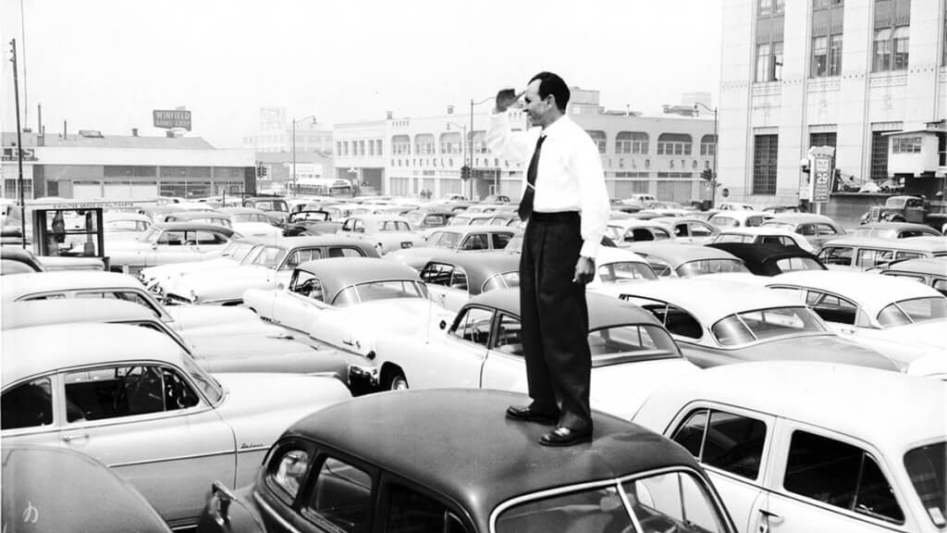
Parking Space Detection and Classification using Machine Learning
CMPE 257
Final Presentation
Charmi | Gerardo | Sravani | Jeevan | Ambarish | Shreya

Slide 2



Project Idea
Finding a parking spot is challenging
Loss of Time
Loss of Fuel
I can’t find a
SPOT !!
Driver Frustration
Loss of Money ($345 on average*)
*According to USA Today

Slide 3
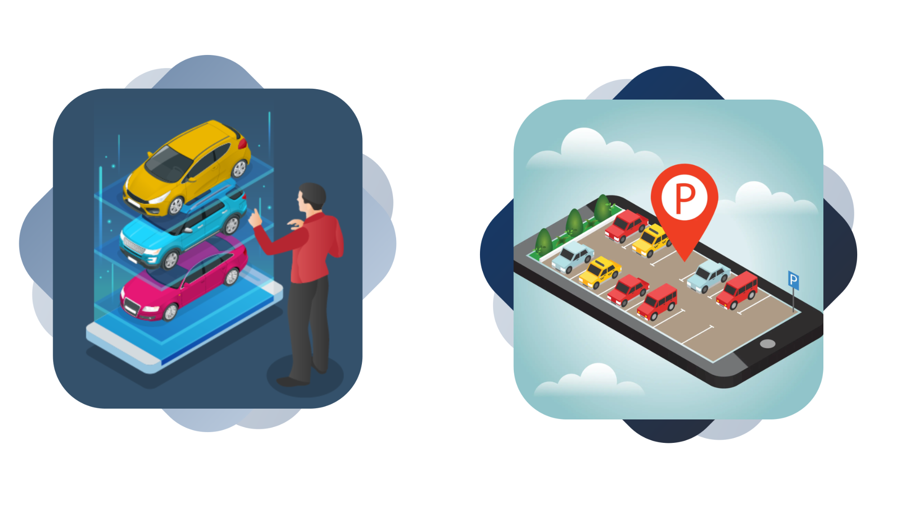

Objective and Dataset
Find an empty
Parking Spot
Which type of car best
fits in the space
PKLot Dataset

Slide 4

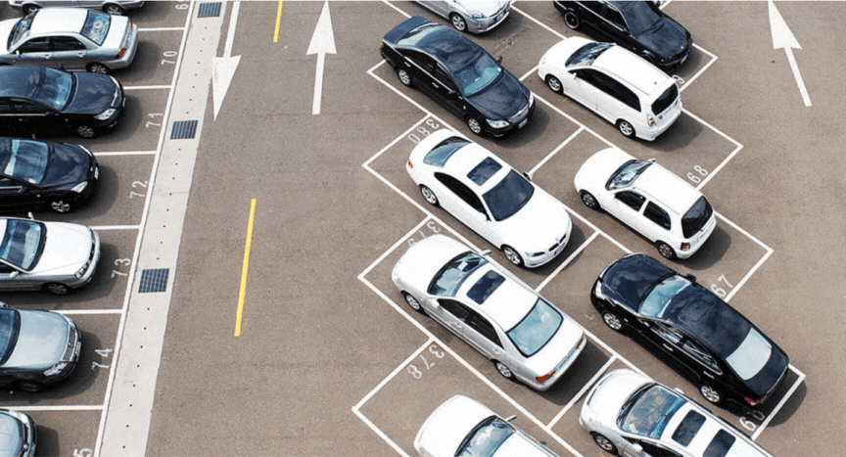
Model 1 - CNN
1
Labels
Definition of parking spots:
JSON file defines the classes and bounding boxes for each parking spot following the COCO format.

Slide 5
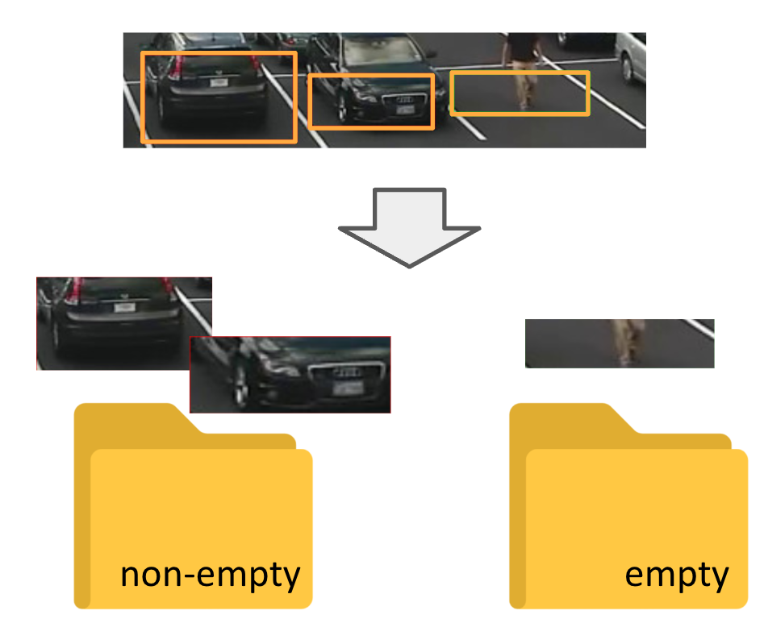
Model 1 - CNN
1
Preprocessing
The dataset is merged and the pictures are cropped into individual parking spots and classified.

Slide 6
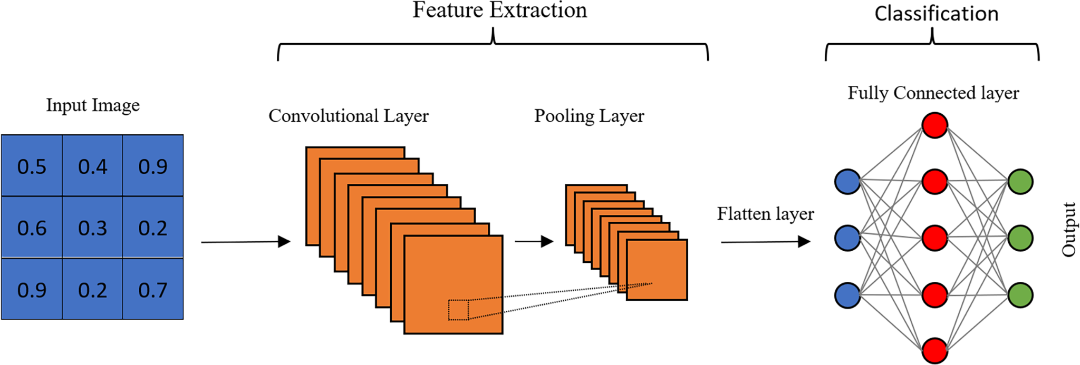
Model 1 - CNN
1
Model Development
A CNN was used for the classification task.
Containing the following layers:
Conv2D: convolution with 24 kernels.
MaxPooling2D: reduce dimensions by half.
Conv2d: convolution with 64 kernels.
MaxPooling2D: reduce dimensions by half.
Dense: fully connected layer with 128 neurons.
Dropout: de activates neurons randomly during training.
Output: one neuron with sigmoid activation that outputs a probability.

Slide 7
Model 1 - CNN
1
Training Metrics
Epoch 1/10
8015/8015 ━━━━━━━━━━━━━━━━━━━━ 167s 20ms/step - accuracy: 0.9551 - loss: 0.1395 - val_accuracy: 0.9698 - val_loss: 0.0767
Epoch 2/10
8015/8015 ━━━━━━━━━━━━━━━━━━━━ 87s 11ms/step - accuracy: 0.9711 - loss: 0.0742 - val_accuracy: 0.9797 - val_loss: 0.0514
……
Epoch 9/10
8015/8015 ━━━━━━━━━━━━━━━━━━━━ 89s 11ms/step - accuracy: 0.9927 - loss: 0.0227 - val_accuracy: 0.9952 - val_loss: 0.0202
Epoch 10/10
8015/8015 ━━━━━━━━━━━━━━━━━━━━ 87s 11ms/step - accuracy: 0.9934 - loss: 0.0211 - val_accuracy: 0.9957 - val_loss: 0.0182

Slide 8
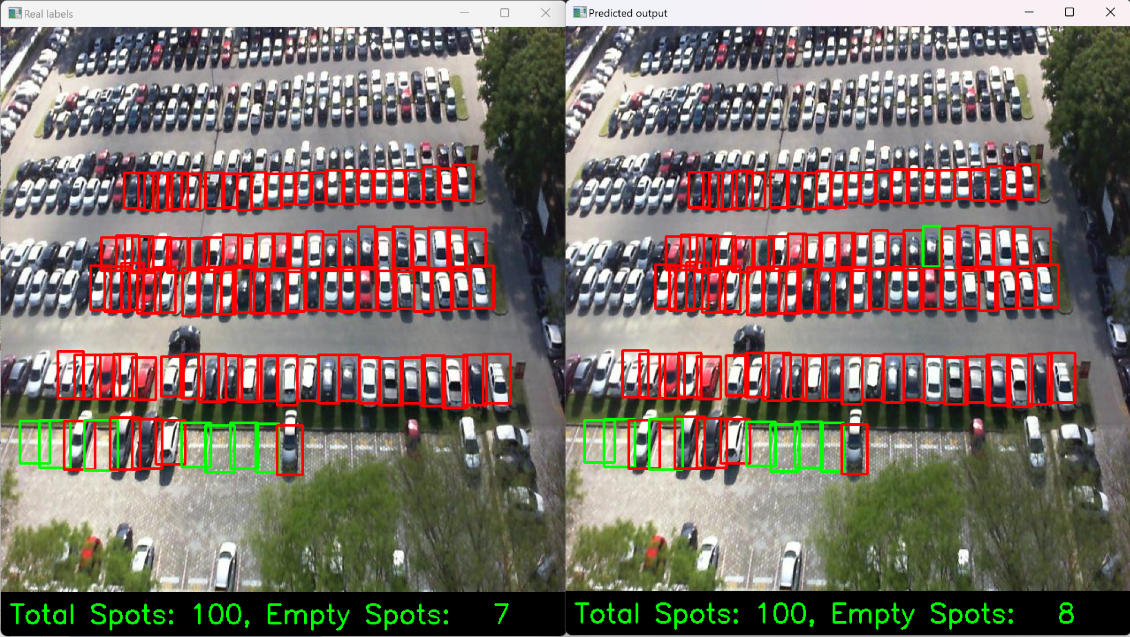
Model 1 - CNN
1

Slide 9
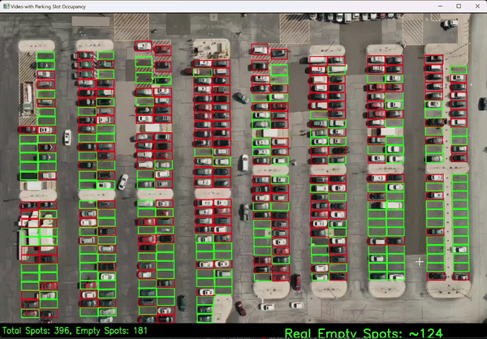
Model 1 - CNN
1

Slide 10
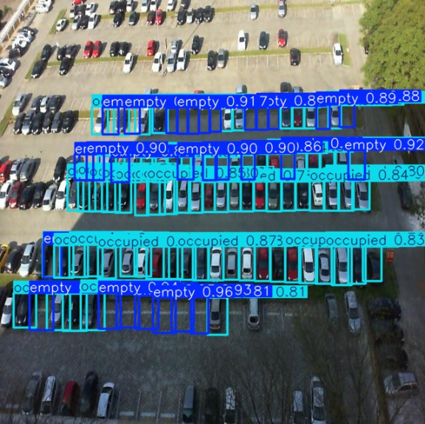

Model 2 – YoloV8
1
Custom trained model: YoloV8
Different learning rates and epochs experimented
Annotations converted to Yolo format
Predicted if parking space is empty or filled
along with the probability

Slide 11

Model Performance
1
Model | Attributes | Accuracy
CNN | Epochs: 10, Optimization Algorithm: Adam | 63%
 | Epochs: 40, Optimization Algorithm: Adam | 81%
 | Epochs: 80, Optimization Algorithm: Adam | 90%
 | Epochs: 40, Optimization Algorithm: SGD | 72%
 | Epochs: 40, Optimization Algorithm: NAG | 86%
 | Epochs: 80, Optimization Algorithm: NAG | 89%
YoloV8 | Epochs: 45; Learning rate: 0.001 | 79%
 | Epochs: 80; Learning rate: 0.005 | 92%
YoloV8 with high epochs
CNN with Adam Optimizer
CNN with NAG Optimizer
Adam: Adaptive Moment Estimation
SGD: Stochastic Gradient Descent
NAG: Nesterov Accelerated Gradient

Slide 12
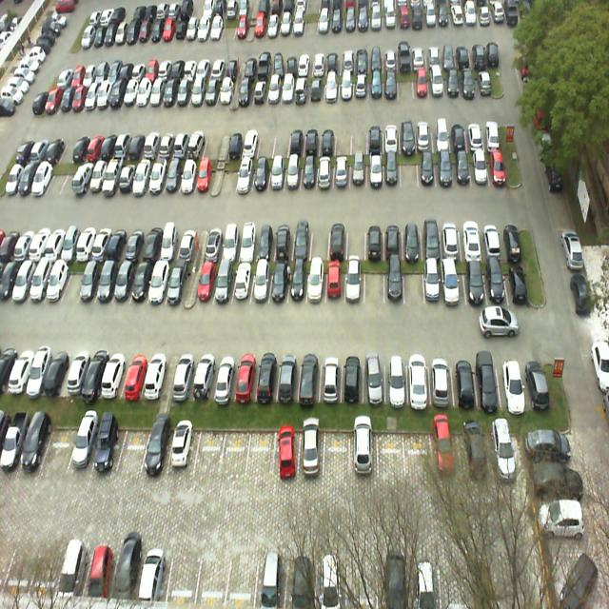
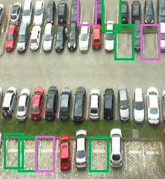
Data Pre-processing and Modeling
2
Subset of PKLot data
Manual Label creation using Roboflow
Bounding box created for compact cars, sedans, SUV and Pick-up truck
For an empty parking space and the distance between adjacent bounding boxes leaving an offset of 6 pixels is calculated
Fit the largest size bounding box
Trained using YoloV5, YoloV8 and YoloV10
Vehicle Type | Dimensions (w * h)
Compact | 40 * 44
Sedan | 41 * 47
SUV | 44 * 48
Pick-Up | 45 * 53

Slide 13

Model Performance
2
Model | Attributes | Accuracy
YoloV5 | Epochs: 40; Learning rate: 0.001 | 36%
 | Epochs: 80; Learning rate: 0.005 | 54%
YoloV8 | Epochs: 40; Learning rate: 0.001 | 49%
 | Epochs: 80; Learning rate: 0.005 | 61%
YoloV10 | Epochs: 40; Learning rate: 0.001 | 51%
 | Epochs: 80; Learning rate: 0.005 | 58%
YoloV8

Slide 14

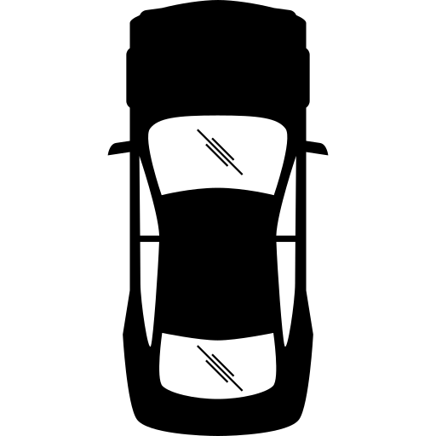

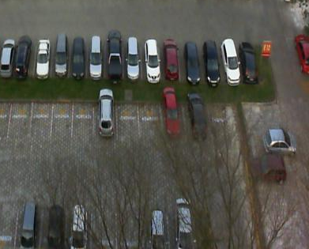
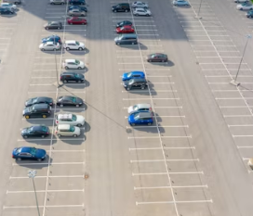

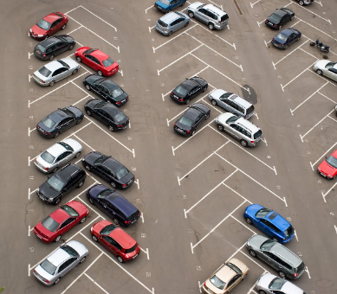
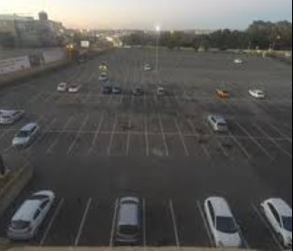
Challenges
Unclear Images
  Impacts accuracy and predictability
  Shadow
  Reflection and Glare
Weather Conditions
  Low light conditions - cloudy days
Labelling of data
Camera Angle
  Angled view
  Fisheye view
Obstruction to parking spots such as trees
Parking Orientation
Icons used from Flaticon.com

Slide 15


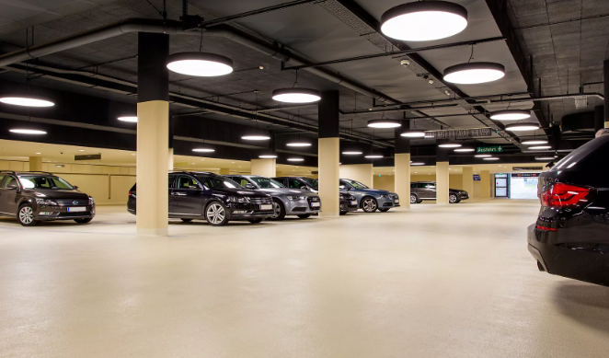

Future Work
Model hyperparameter tuning for improved accuracy
Parking Direction System
  Build an application to identify and direct users to empty parking spaces
Parking Spot Prediction
  Predict potential parking space using historical data
Auto bounding box size and orientation detection
Covered parking
  Indoor parking
  Multi level parking

